Slide 1

Boat Finder Progress PPT
Mobile Commerce Technology By :- (Group 5)Gurdarshan Singh and Amit Morade

Slide 2

Introduction
The Boat Finder application is a platform aimed at revolutionizing the boat rental industry. With a comprehensive set of features, it aims to bridge the gap between boat owners and users, offering a seamless and convenient rental experience.

Slide 3
Main Functionality
Login and Sign Up Screens
Viewing Boat Details
Profile Management
Cloud Database Integration
Integration with Google Maps

Slide 4
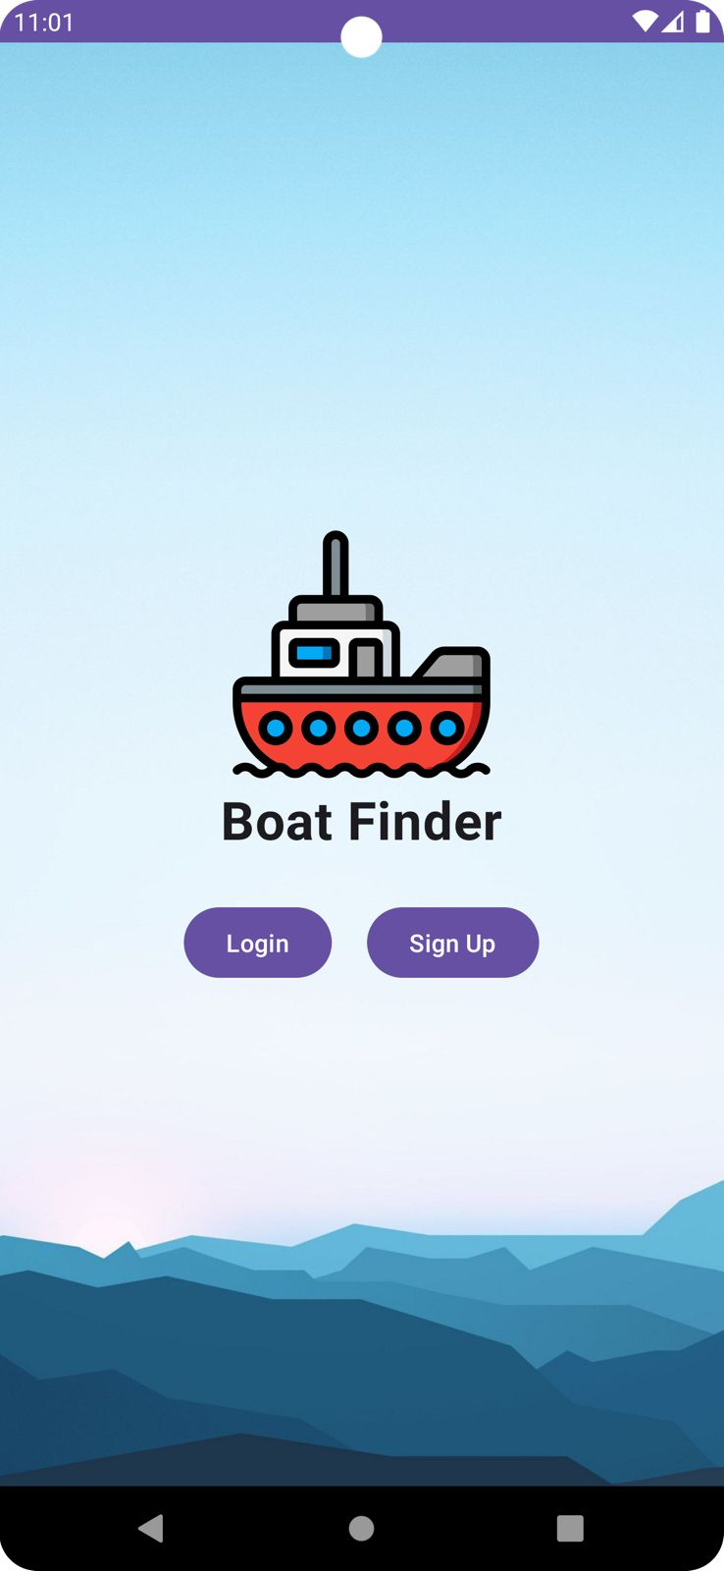
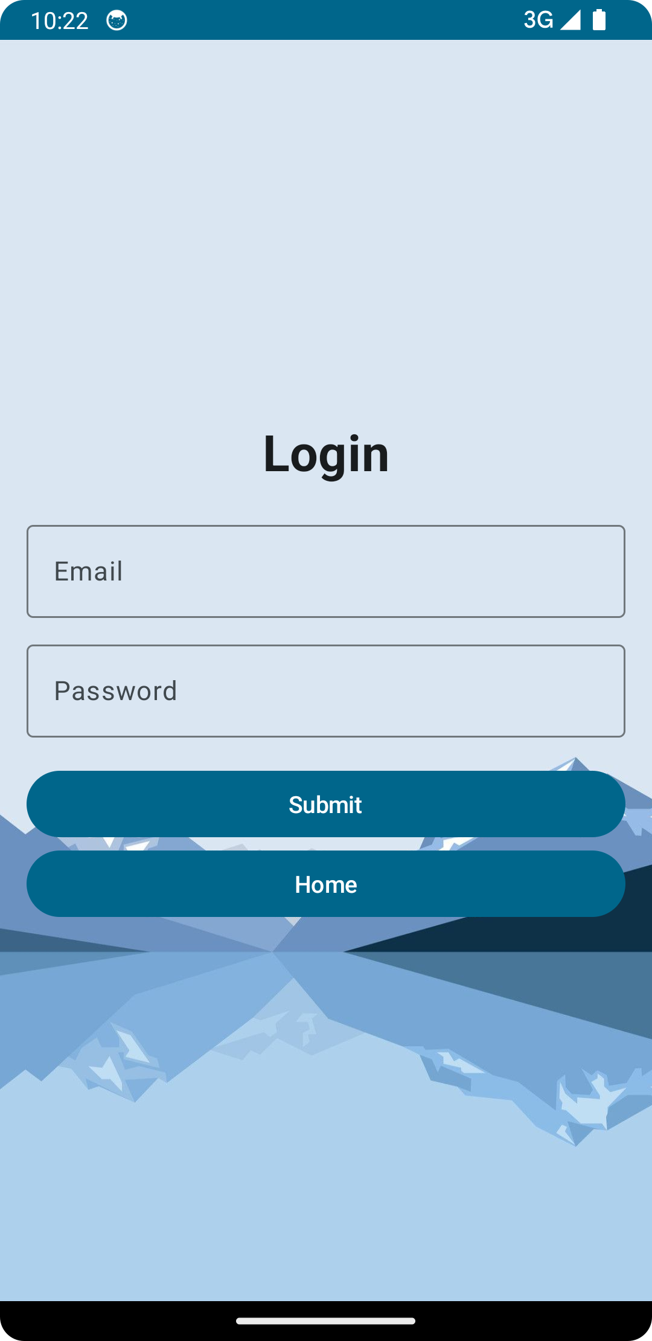
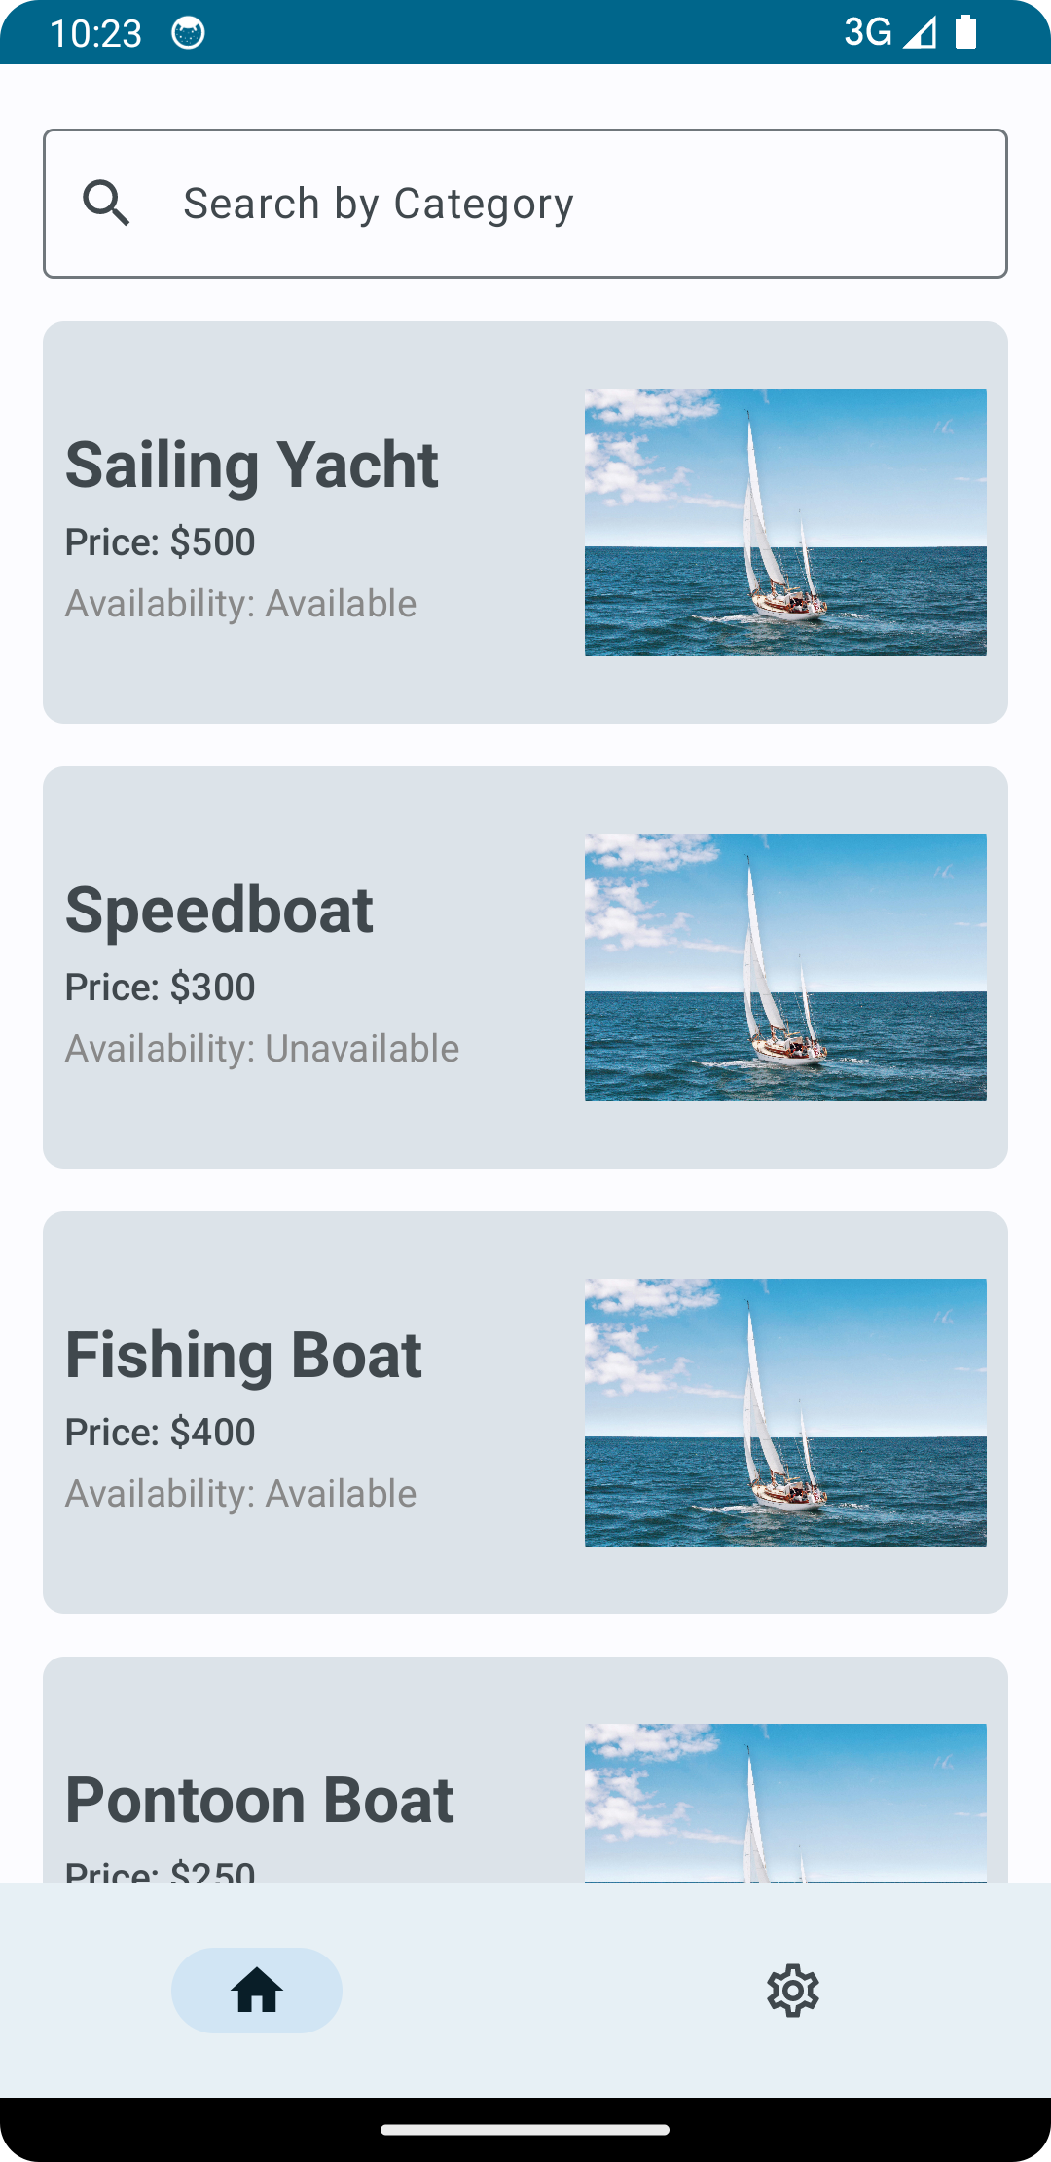
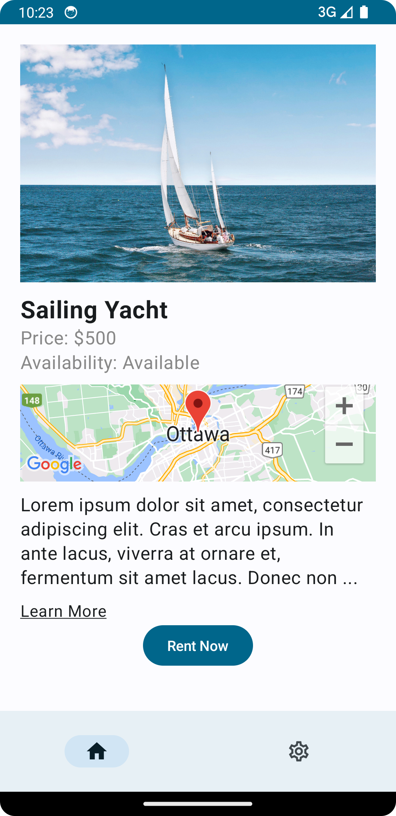
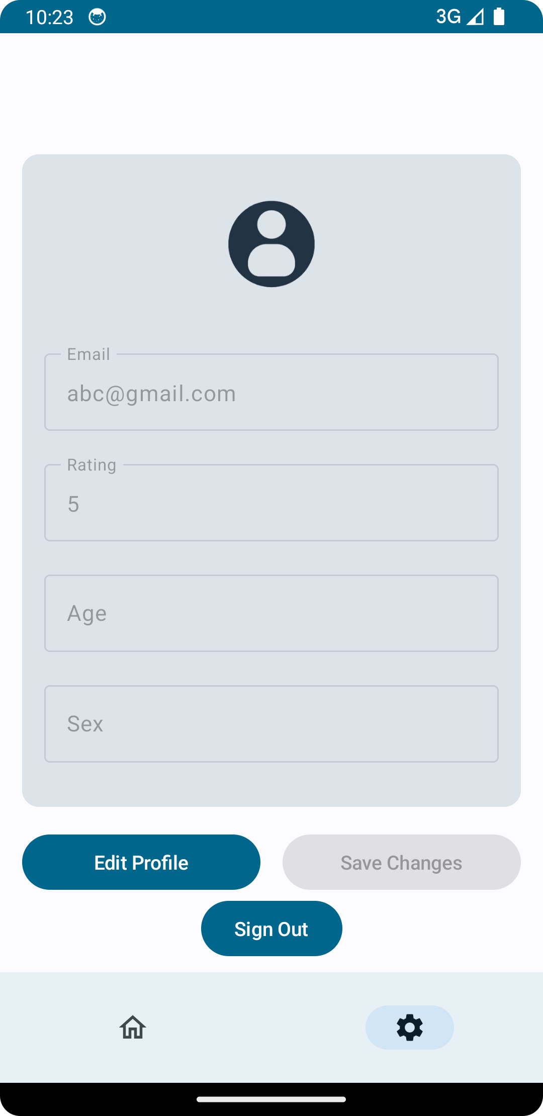
Current Layouts

Slide 5
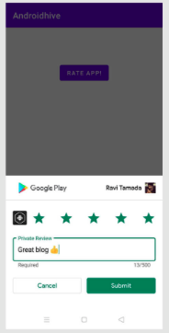
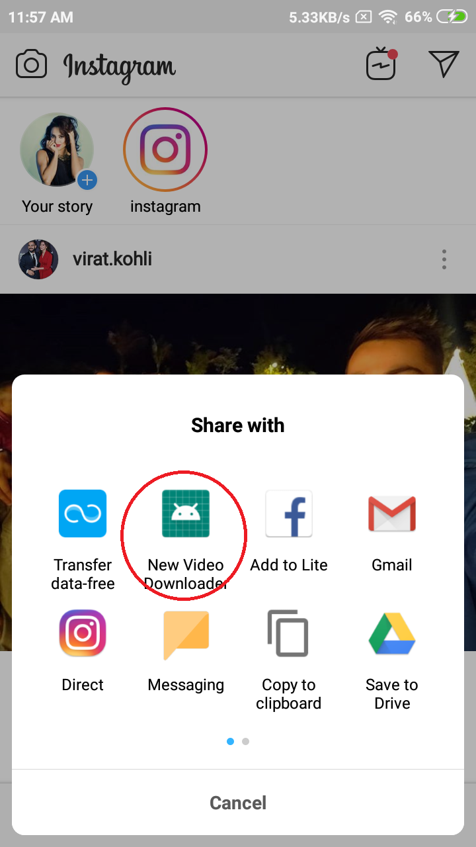
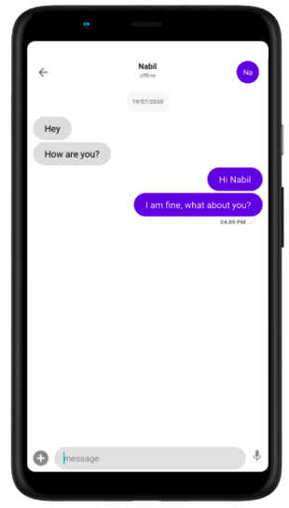
Planned Layouts

Slide 6
Advanced Features Implemented
Firebase Authentication for Secure Login
Integration with Google Maps for Location Services
Cloud Database for Storing Boat Listings and User Data

Slide 7
Advanced Features Planned
Social Media Sharing for Sharing Boat Listings
Chat Functionality for Communication with Boat Owners
Owner Rating System for User Feedback

Slide 8
Challenges Faced
Integrating Google Maps API
Database Integration

Slide 9

Conclusion
In conclusion, the Boat Finder application represents a significant advancement in the boat rental industry. With its innovative features and user-centric approach, it aims to make boat rental accessible, convenient, and enjoyable for all parties involved. By leveraging technology and fostering community engagement, the application is poised to revolutionize the way people rent and enjoy boats.

